Slide 1
Lighting and Shading
Computer Graphics Introduction
Summer 2020

Slide 2
What does it mean?
Now that we’ve learnt how to find which pixel to light, the final challenge lies in knowing what to light up the pixel with. This is easy. All we can do with a pixel is light it up with some colour. This colour, however, depends on
The colour of the object
The material properties of the object
The colour of the light source
The angle of viewing with respect to object/light
And potentially many more...

Slide 3
Some Related Terms
This is what Lighting and Shading will help us achieve. We use a lot of physics to find the colours of each pixel.
Illumination Model How to “light” an object point given it’s material properties, the light sources surrounding it, the angle of the camera etc.
Shading Model How the illumination model applies to our objects, namely polygons and points
Lighting Different types of lights
Shadows How shadows are cast by our objects

Slide 4
Representing Colour
What do we write into the frame-buffer after identifying which pixels belong to a primitive? All we need is the colour and intensity. For the longest time, we’ve defaulted to a 3-color 8-bit displays, showing Red, Green and Blue. These three colours have been picked because of what we call the Tristimulus Theory, and also because this is how our eyes see colour, too. The spectral responses of the cones of our eyes respectively peak approximately at 575 nm, 535 nm, and 445 nm.

Slide 5
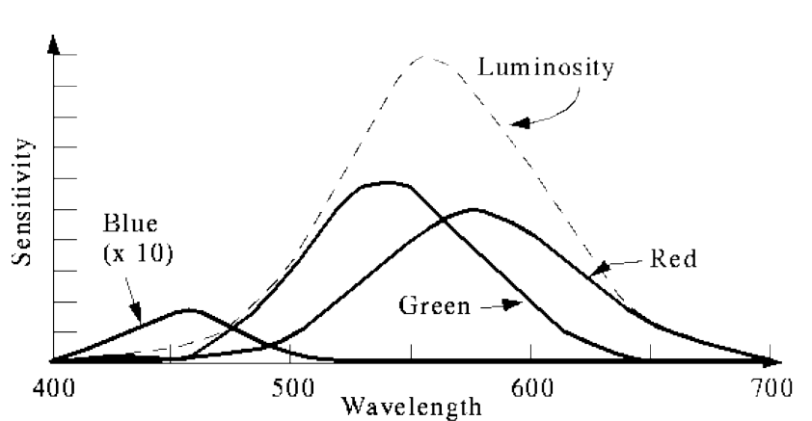
Representing Colour
This is the visible portion of the electromagnetic spectrum: From about 400 nm (Violet) to 700 nm (Red). With varying levels of sensitivity, about the entire visible spectrum can be computed based on these three colours.

Slide 6
Tristimulus Theory
All perceivable colours can be specified as weighted combination of primary colours R, G, and B. Here, RGB define a set of basis vectors. Mix them in different measures to get
any colour.
This property is quite attractive to us, because a very compact representation is possible, and can is still quite accurate at representing real world colour. Outr problem now reduces to: Find RGB values to approximate a given perceptual colour

Slide 7
A Note on Different Colour Spaces
RGB Model These are called the Additive Primaries. All colors begin with black "darkness", to which different color "lights" are added to produce visible colors. RGB "maxes" at white, which is the equivalent of having all "lights" on at full brightness (red, green, blue).
CMY (K) Model These are called the Subtractive Primaries. All colors start with white "paper", to which different color "inks" are added to absorb (subtract) light that is reflected.
They are essentially doing the exact same thing. Combination of the primary colours of RGB yield the primary colours of CMY, and vice versa. RGB is very popular in digital screens, and CMY has become the default for print media.

Slide 8
Illumination Model

Slide 9
About Illumination Models
Like we said, illumination models describe the modelling of the interaction with light and an object point from the point of view of the camera image. Three factors come into play: light source properties, material properties, and atmospheric effects. Light Source Properties They emit light, and they can have colour and directionality.
Material Properties Different materials interact with light differently. They can have colour, reflectivity, transparency etc.
Atmospheric Effects Ambient light, and most importantly, attenuation

Slide 10
Material Properties - Reflectivity
Reflectivity is just how light interacts with the object. We call objects shiny, dull., grainy etc. In practice, it’s often hard to separate these properties, because real world objects display a variety of lighting effects at the same time. As a result, we try to replicate the combined effect of these properties, without worrying about how they work independently. Generally, we’ve settled on two broad sort of lighting reflection techniques -
Diffuse Reflection For dull and rough objects
Specular Reflection For smooth and shiny objects

Slide 11
Diffuse / Lambertian Reflection
Again, for rough and dull objects. Things like cloth, a rough wall, the floor etc. The important thing to know about objects like these is that the normal component of light falling on it is absorbed by the object and is then reflected back equally in all directions. There’s really no preferred direction for reflecting light falling on it. Appearance of the point is (usually) independent of the angle from which you view it.
Using the laws of reflection, the normal component of light is proportional to cos θ.

Slide 12
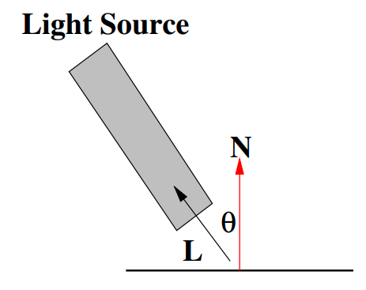
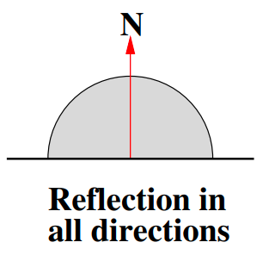
Diffuse / Lambertian Reflection
The reflected light, equally in all directions, is proportional to I_{L} cos θ

Slide 13

Diffuse / Lambertian Reflection Equation
The formula for computing the intensity at a point.
k_{d} is the diffuse reflection coefficient. And θ is between 0 and 90.

Slide 14

Detour to Colour of the Material
Like we said, the colour of an object is actually the light that it reflects. All other light is absorbed by the object. A fully red object has colour (1, 0, 0). It reflects all of the red falling on it and none of the green or blue. To represent this, we need to know the spectral composition of the light falling in the object. To include the colour of the reflected light, we just include the colour parameter of the material in the equation of diffused light.

Slide 15
Shiny Objects and Highlights
Shiny objects (smooth metal, polished marble) reflect light differently. We can usually see a highlight (of the reflected light), which is sort of like a bright spot of reflected light. This highlight has the colour of the light source, irrespective of object colour. This highlight also moves with the viewing angle. Appearance of the object point depends on. This is called specular reflection.

Slide 16
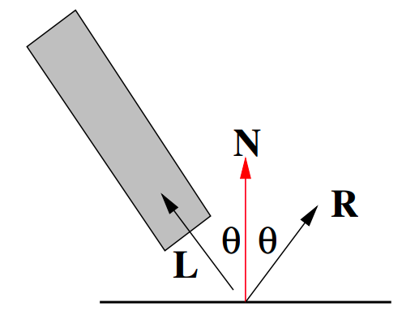
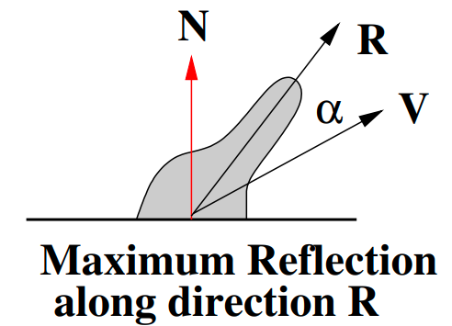
Shiny Objects and Highlights

Slide 17
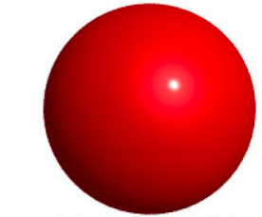
Specular Reflections
A distinguished direction exists for reflection, depending on the incident light direction, and normal direction. This reflection quickly falls off as our view moves away from this angle. We reflect the light vector about the normal vector to get the specular reflection direction. Laws of reflection, again.

Slide 18
The Phong Model of Specular Lighting
α is the angle between the reflection direction R and the view direction V. Phong’s Model -
Sometimes, specular colour O_{Sƛ} is also added!

Slide 19

Ambient Light
In any kind of graphics scene, some light is always present. We call this the ambient light I_{a}, and this light is present everywhere. It’s sort of like the net effect of all light that reflects from around the environment. The final equation that we’ve arrived at now
This is a combination of all the lighting reflections we’ve seen so far

Slide 20
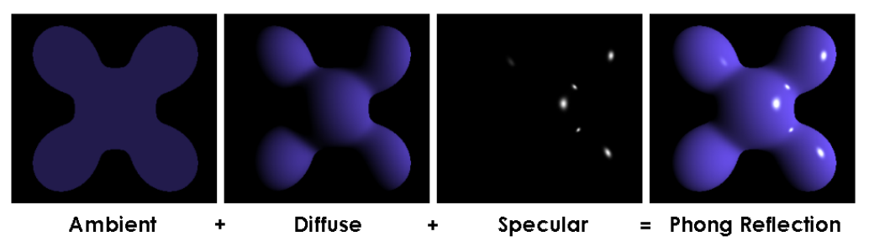
This is what it looks like

Slide 21

Atmospheric Effects
The most straightforward atmospheric effect is attenuation. It’s basically how any signal will deteriorate over a distance. The light that reaches the point I = f_{att} I_{p}. This attenuation factor, according to real work physics, is ∝ 1/d_{L}²
In practice however, this doesn't work as well, as the light deteriorates too quickly.

Slide 22
One Light to More
With attenuation, our illumination equation is now
When there’s multiple light sources involved, only diffused and specular reflections are added up.

Slide 23
A Note about Emissive Colour
We can have objects that emit a colour, like a coloured tube light as an object.
We usually don’t treat emissive objects as light sources automatically. The material property can include emissive colours for such self luminous objects. This emissive colour is added to each point of the object, and only the appearance of that object is affected.

Slide 24
Shading

Slide 25
Shading Models
The illumination equation can be evaluated at every pixel to compute the colour/intensity there.
This is expensive computationally. We can try taking advantage of the coherence, or the fact that we are actually computing values for a planar polygon. We have different options available for this.

Slide 26
Constant / Flat Shading
The simplest method of shading. We just calculate the illumination equation once per polygon, and apply the colour and intensity to the entire polygon. Each polygon would get one colour, and looks flat. It’s the most computationally easy method, and can often work surprisingly well, especially for polyhedral objects (think Minecraft). What point to pick (center? some vertex?) can be an artistic choice, and results vary.

Slide 27
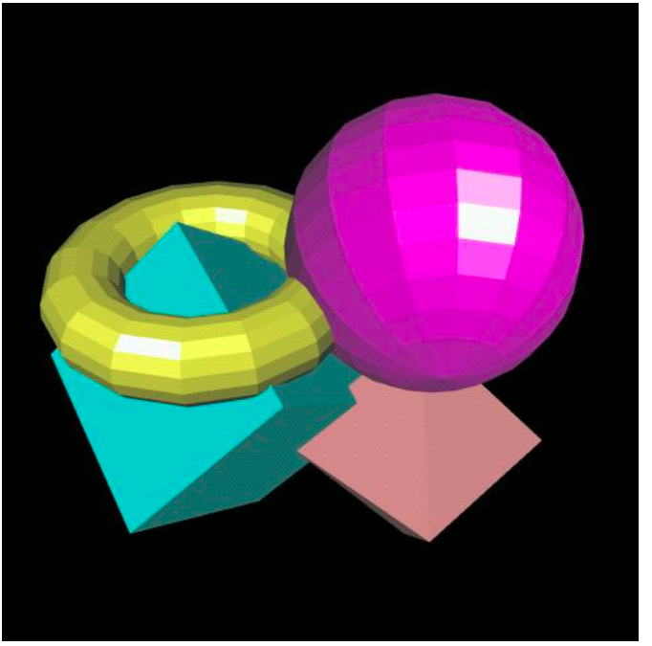
Constant / Flat Shading

Slide 28
Some More Shading Models
Clearly, flat shading results can be very unsatisfactory. We have a number of options.
Interpolated Shading Interpolated shading assumes that properties can be calculated at the vertices and can be interpolated for the interior points.
Gourard Shading Interpolated Colour Shading. A slightly more involved method of using exact normals. Interpolate along scan lines using intensities at the edges. This can be combined nicely with the computation we perform on spans of polygons nicely.

Slide 29
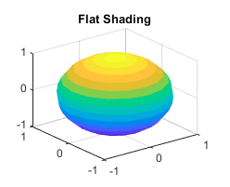
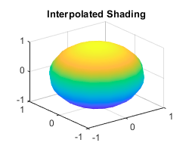
Gourard Shading

Slide 30
Including Specular Highlights Under Interpolation
When a curved object is approximated using a polygon, adjacent polygons could have different intensity values. Flat shading will bring it out sharply; object will appear faceted.
Interpolated shading may not help much if neighbouring polygons have
different normals. If we can manage to keep a parametric or analytic representation of the object that is approximated, then exact normals can be computed at each point.

Slide 31
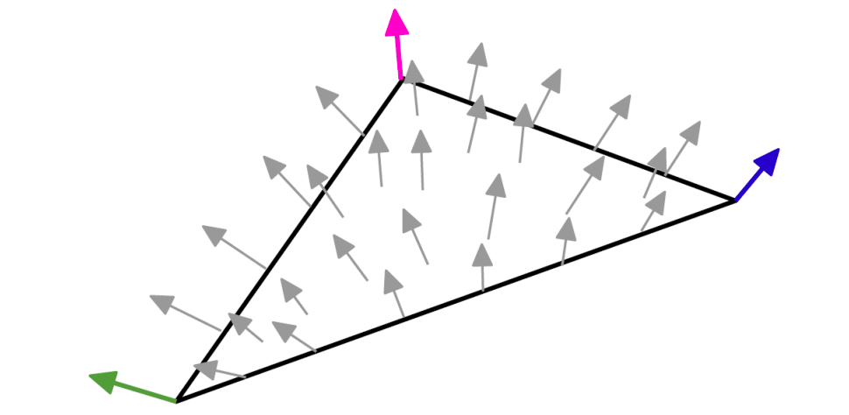
Phong Shading
Phong shading does exactly that. Computes highlights very well, and is your best way of computing them well. Computation time is considerably more. Again, optimisations are introduced in this. A technique called normal vector interpolation shading is quite popular. We don’t quite calculate normals at every single point, but build a dense enough map of normals.

Slide 32
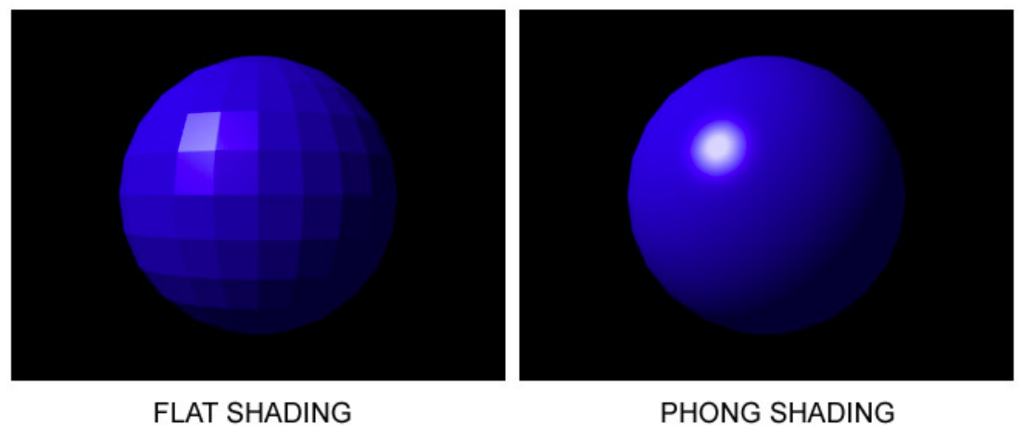
Phong Shading

Slide 33
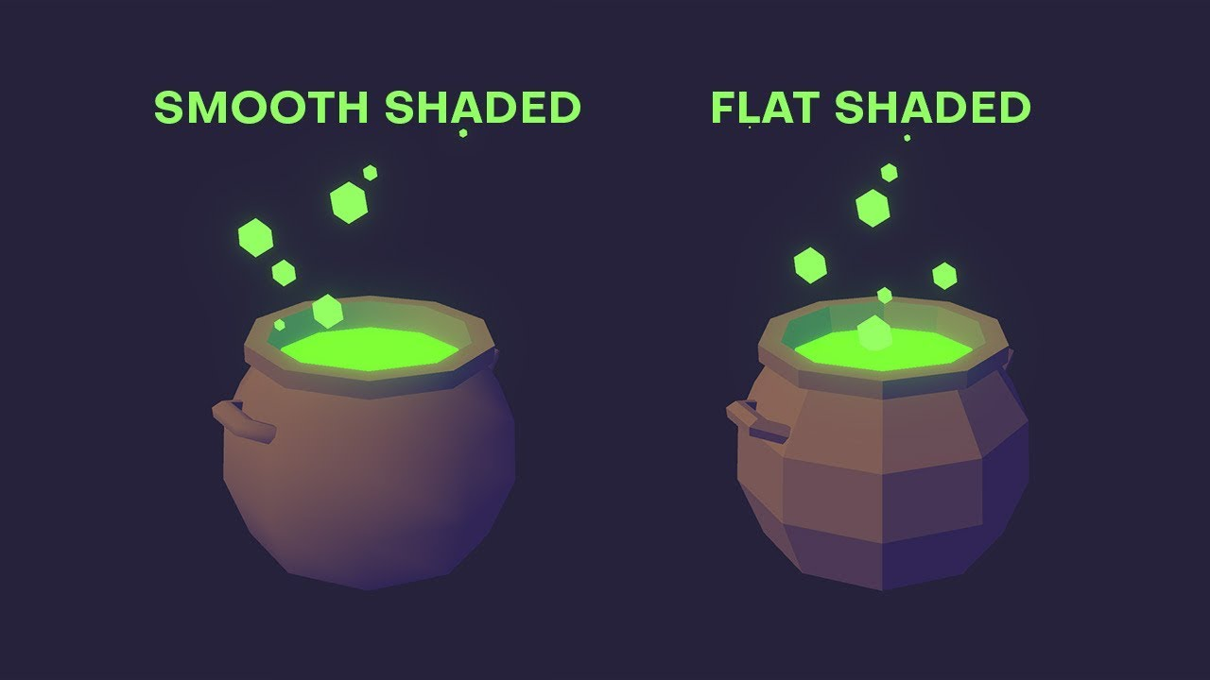
Phong Shading

Slide 34
Light Sources

Slide 35
Common Types of Light Sources
Ambient Light No identifiable source or direction
Point Source Given only by point
Distant Light Given only by direction
Spotlight From source in direction
Cut-off angle defines a cone of light
Attenuation function (brighter in center) •
Light source described by a luminance
Each color is described separately
I = [I_{r} I_{g} I_{b} ] T (I for intensity)
Sometimes calculate generically (applies to r, g, b)

Slide 36
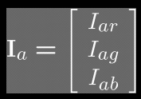
Ambient Light
Intensity of this light is the same at all points.
This light does not have a direction (or .. it is the same in all directions)

Slide 37
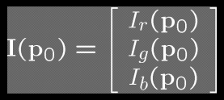

Point Source Light
Given by a point P₀
Light emitted from that point equally in all directions
Intensity decreases with the square of distance.

Slide 38
Point Source Light
Given by a point P₀
Light emitted from that point equally in all directions
Intensity decreases with the square of distance.

Slide 39
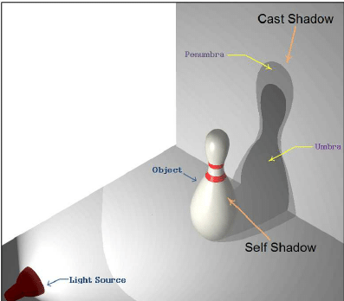
Point Source Light Shadows
A limitation of point source lights is something called the penumbra. This is a very real world phenomenon, that’s often hard to deal with in graphics. Think of it like ambient shadows. Not including this makes your scene appear unrealistic.

Slide 40
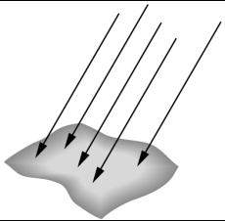
Distant Light Source
Given by a vector v
Intensity does not vary with distance (all distances are the same)

Slide 41
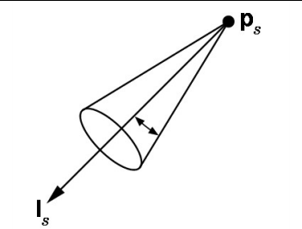
Spotlight
Most complex real world source light to model
Even though light still emanates from point, the spread of light is determined by a “cut-off” cone, with an angle θ.

Slide 42
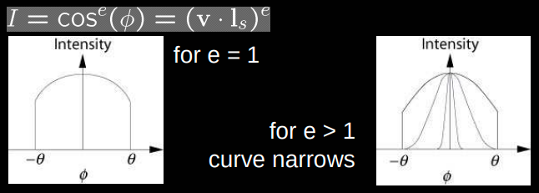
Spotlight Attenuation
Spotlight is brightest along the main ray of incidence. Since it’s often modelled as a vector v with angle ɸ from p to point on surface, and it’s intensity is modelled as cos ɸ. There is also a spotlight exponent e that determines rate of drop off of intensity.

Slide 43
Thank you!

Slide 44
Useful References
Spring 2019’s Graphics Course Slides on Lighting and Shading https://drive.google.com/file/d/1bgmSQzodbJw0knkapXilcQnk4Rz0cGKI/view?usp=sharing
Spring 2019’s Graphics Course Slides on Ray Tacing https://drive.google.com/file/d/1_GQo3xFEx3t3zA83m00NA8AhJHJpLXXl/view?usp=sharing
Carnegie Mellon School of Computer Science - Lighting/Shading http://graphics.cs.cmu.edu/nsp/course/15-462/Spring04/slides/07-lighting.pdf
Worcester Polytechnic Institute https://web.cs.wpi.edu/~emmanuel/courses/cs4731/A14/slides/lecture16.pdf

